Slide 1
Making Matches – Recommending the right Personalities
Current Tpoics in Web Applications, Information Management and Semantics Summer Term 2018

Slide 2
Introduction
Recommender Systems help people to engage in meaningful ways
?
?
Notes:
Here we will focus on connections between users

Slide 3
Core Concepts: User Modeling
User Modeling
Recommendations have to be adjusted for an individual user
User Models encompass everything we deem relevant about our user
[ PERSONALITY ]
[ SITUATION ]
[ PREFERENCES ]
[ RESOURCES ]
[ NEEDS ]
[ SKILLS ]
[ CONTACTS ]
Steve
Notes:
Two core concepts, that will be discussed looking at a specific paper: User Modeling and Reciprocal Recommendations
„But I don‘t remember this topic coming up in the list of topics earlier this semester!“
That‘s right, I messed up and proposed my own topic instead of summarizing an existing one. Dr. Rensing was cool about it, found a fitting paper as a starting position, and set me up to go.

Slide 4
Core Concepts: User Modeling
User Modeling
Recommendations have to be adjusted for an individual user
User Models encompass everything we deem relevant about our user
[ SITUATION ]
[ PREFERENCES ]
[ SKILLS ]
[ CONTACTS ]
Steve

Slide 5
Core Concepts: User Modeling
User Modeling
Recommendations have to be adjusted for an individual user
User Models encompass everything we deem relevant about our user
[ PERSONALITY ]
[ NEEDS ]
Steve

Slide 6
Core Concepts: User Modeling
User Modeling
Recommendations have to be adjusted for an individual user
User Models encompass everything we deem relevant about our user
[ PREFERENCES ]
[ RESOURCES ]
[ SKILLS ]
Steve

Slide 7
Core Concepts: User Modeling
User Modeling
Recommendations have to be adjusted for an individual user
User Models encompass everything we deem relevant about our user
[ PERSONALITY ]
[ SITUATION ]
[ RESOURCES ]
[ NEEDS ]
Steve
Notes:
We also need to discuss how said data is collected: do we simply ask the user? Or his or her peers? Can we use specific assumptioms? Can we access systemic data (interactions, exercise results, engagement rates, …)

Slide 8
Core Concepts: Reciprocal Recommendations
Reciprocal Recommendations
Users receive users as recommendations and is in turn a recommended item
Truly reciprocal when a user is recommended to his own recommended users
Online dating, gaming matchmaking, social networks, group formation, …
Notes:
Can you find a reciprocal recommendation?

Slide 9
What is this talk about?
Reciprocal Recommendations
Users receive users as recommendations and is in turn a recommended item
Truly reciprocal when a user is recommended to his own recommended users
Online dating, gaming matchmaking, social networks, group formation, …
Notes:
Here we can see a reciprocal recommendation: In all the other cases, one user poses a good fit for another user, but would not receive any benefits from that matchup themselves. In reciprocal cases, both users would benefit from a meeting.

Slide 10
Reciprocal Peer Recommendation for Learning Purposes
System
adaptive, web-based, student-facing, multi-purpose learning platform
Classical e-learning platform capabilities and recommendation of learning capabilities
RiPPLE -> „Recommendation in Personalized Peer Learning Environments“
User Model
Topic-wise competency (derived from e-learning results)
Available timeslots
Roles: Topics in which a user would like to
Find a learning partner
Receive peer support
Give peer support
Preferences regarding competency differences for each role
Combine user‘s learning needs and capabilitiies

Slide 11
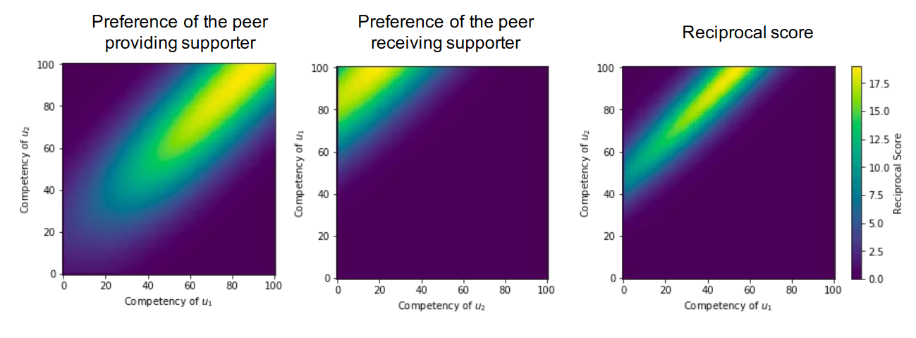
Reciprocal Peer Recommendation for Learning Purposes
Recommendations
If their timeslots and roles are compatible, calculate two one-directional scores for every pair of users
Calculate the harmonic mean of these two values, leading to a reciprocal, symmetric score for each match
Return a list of k recommendations to each user
Notes:
Harmonic mean emphasizes values that are close to the middle.
Even using the harmonic mean, recommendations don‘t have to be reciprocal

Slide 12
Reciprocal Peer Recommendation for Learning Purposes
Evaluation
Completely artificial data
Main question: How would the system perform in real life?
Quality metrics:
Scalability
Reciprocality
Coverage
Quality
No specific goals set
Future Plans
Practical evaluation in college courses during 2018

Slide 13
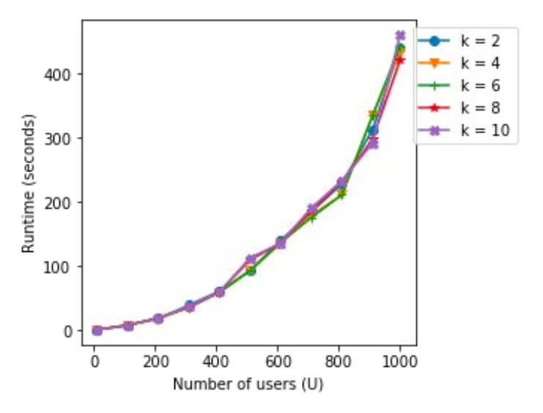
Scalability

Slide 14
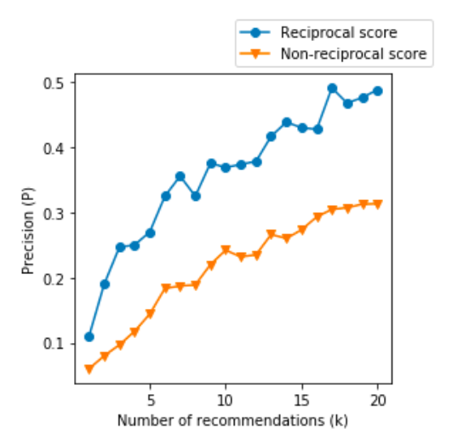
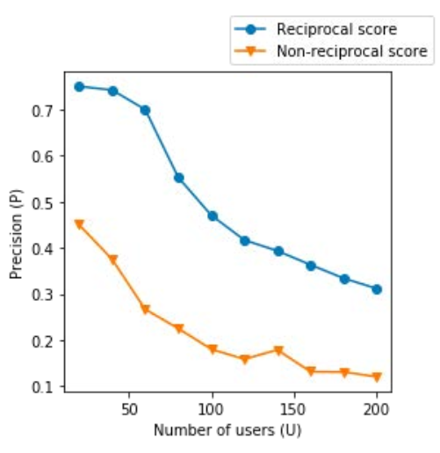
Reciprocality

Slide 15
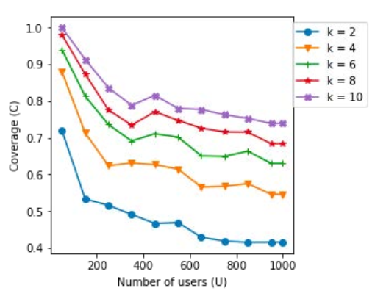
Coverage

Slide 16
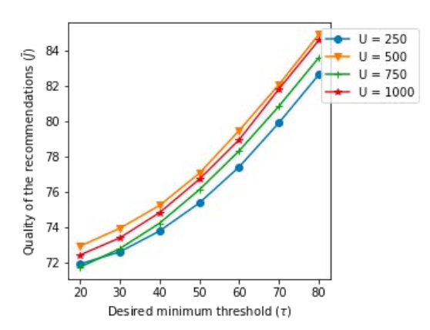
Quality

Slide 17
Discussion
RiPPLE‘s shortcomings
No consideration of abandoned users
No learning groups, only pairing
How would users know their competency difference preferences?
User Modeling
Especially important in reciprocal scenarios, where users are items
Overspecification leads to random recommendations
Data Collection Problems [See next slide]

Slide 18
Discussion – Data Collection Problems
Explicit user data
Self-reported by users about themselves (e.g. feedback, ratings, …)
biased by inability to properly report information
Source: Dude, trust me. [Doing my Masters in Psychology in IT]
Psychology was founded to collect information about people, e.g. via tests
Implicit user data
Online data collected during usage
Cold start problem: Users would have to be randomly assigned at first
Operationalization problems:
How do we measure „fun“ in games? How do we measure sympathy between users?
Source: Dude, trust me.
Notes:
Operationalization problems: how do we know what systemic data describes what we want to know?

Slide 19
Summary
User Modeling
Highly important to be able to properly recommend items
Depending on many different factors
Data can be hard to acquire
Reciprocal Recommendations
Valuable mechanism to help people find meaningful engagements
Ensure benefits for all participants

Slide 20
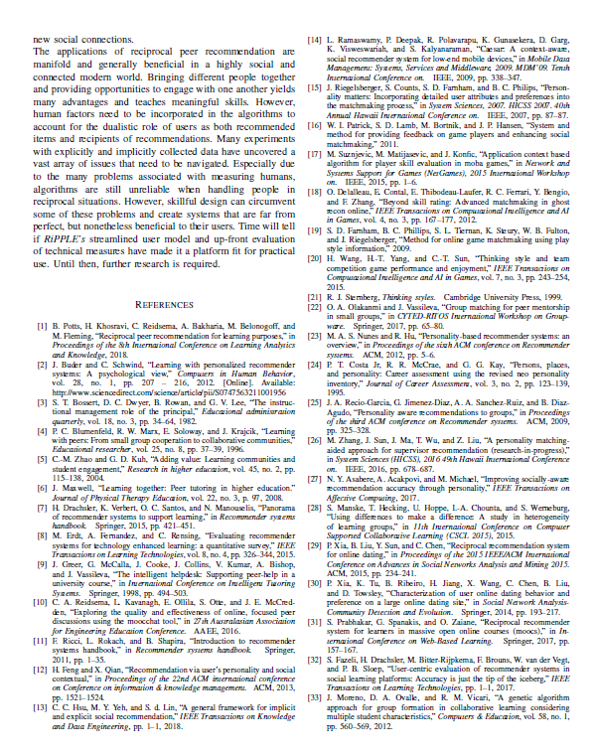
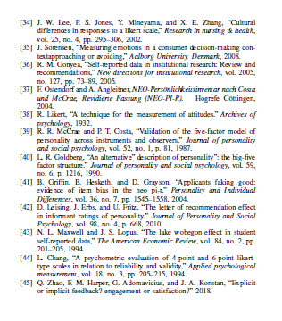
References
Potts, B. A., Khosravi, H., Reidsema, C., Bakharia, A., Belonogoff, M., & Fleming, M. (2018, March). Reciprocal peer recommendation for learning purposes. In Proceedings of the 8th International Conference on Learning Analytics and Knowledge (pp. 226-235). ACM.
Aaaand lots more, found in the paper. Seriously, I couldn‘t list them here.

